Slide 1
Year 3 GP Tutor Update
Dr Louise Sands
2024/25 – 3rd September 2024
Notes:
Introduce ourselves and work contexts and why we love GP!

Slide 2
Need to know
Complete the MS form Click to claim attendance
Session is informal
Add questions/comments in chat
Feel free to interrupt to ask questions
Sharing the expertise of the group
Aim to finish by 4pm

Slide 3

A big thank you!

Slide 4

Objectives for this session
Student Feedback from 23-24
Overview of Year 3 GP placement
Home visits
Assessment / MyProgress
Sharing ideas for managing 6 students in practice

Slide 5

What experience have we in this group?

Slide 6

What did the students say?

Slide 7
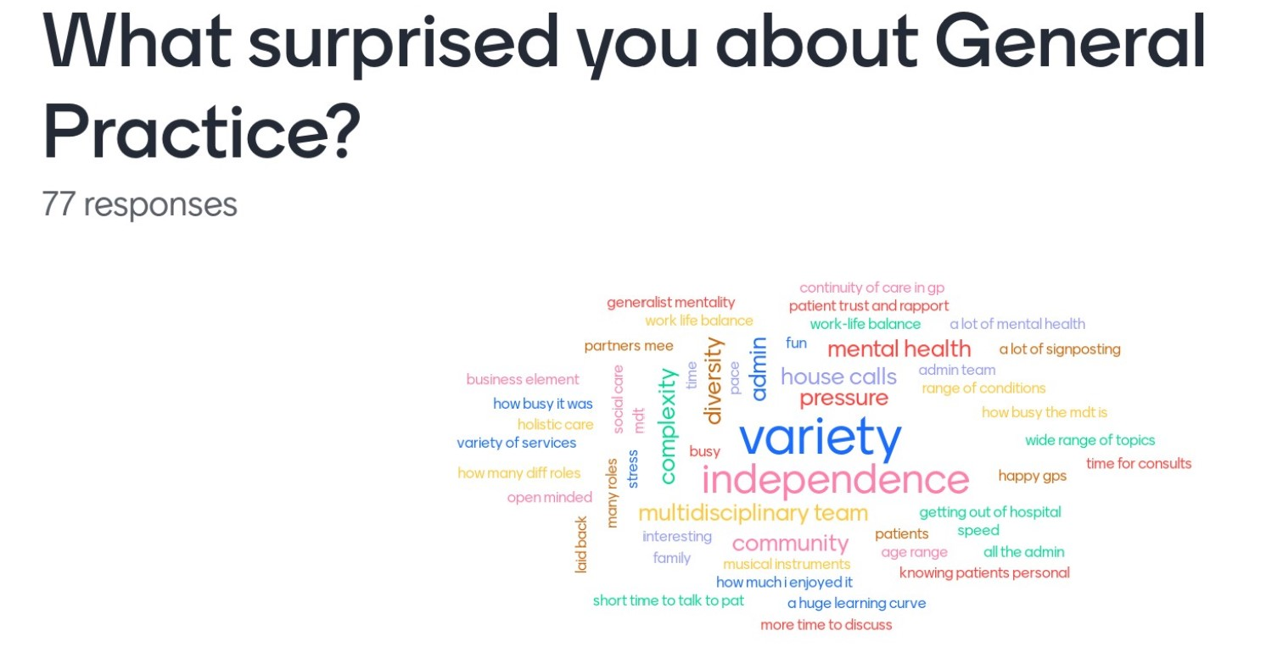

Slide 8
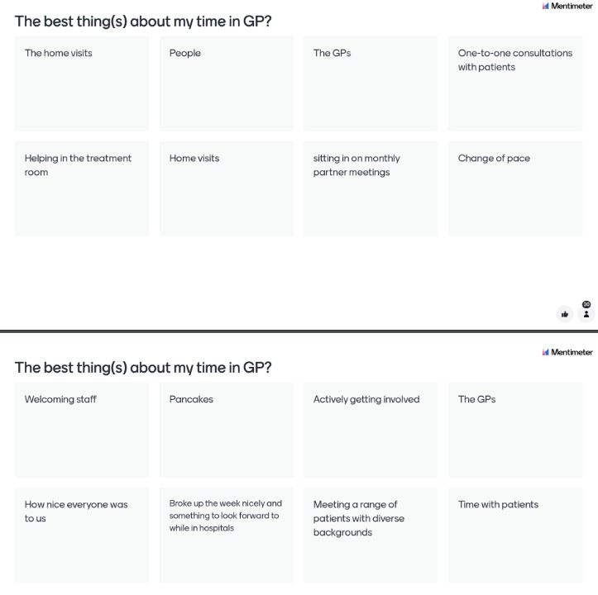

Slide 9
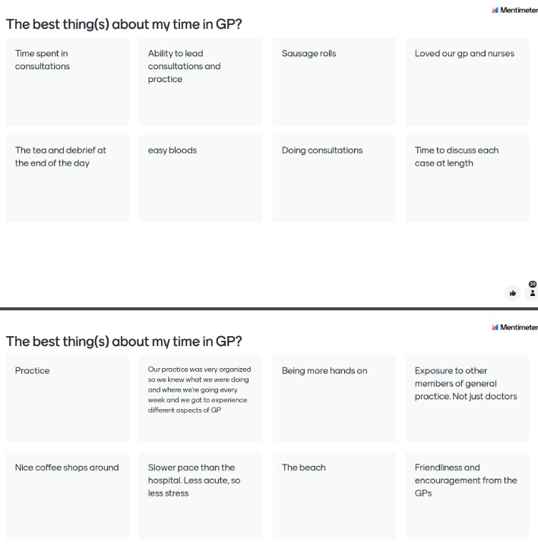

Slide 10
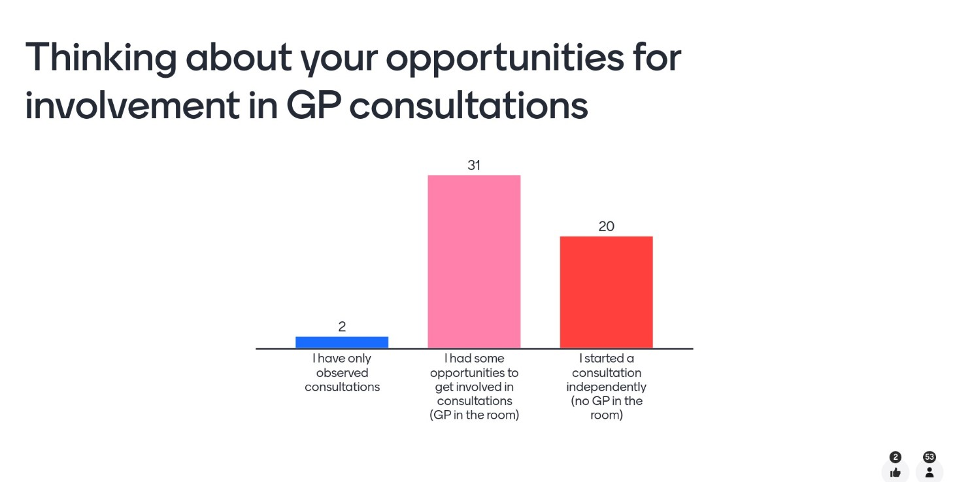

Slide 11
What “stood out” for students?
We got the opportunity to lead consultations and examine patients. We had the chance to ask questions and talk through the consultations beforehand. We had the opportunity to practice clinical skills e.g. taking blood and blood pressure
The warm welcoming and supportive nature of all the practice staff. The independence afforded to us by the GP to consult and/or examine patients where it was appropriate before relaying back to the GP really aided my learning. The supportive constructive feedback after every session I felt was of great use as there were certain niches to each consultation that I will never forget.

Slide 12
How did students think placement could be improved?
Less students in group Less time and cost travelling Less Virtual Primary Care (VPC) Equal experience for students in terms of time with MDT and other team members More info on how practice works as a business
Allow more time in treatment room e.g. bloods, ECGs, obs, urinalysis Allow to do more individual consultations Allow to do Home Visit Time at chronic disease management clinics e.g. asthma, COPD, CVD,DM and to practice PEFR,etc

Slide 13
Aims of Year 3 GP Placement
For students to understand the structure, principles and practice of GP work, and how primary care is different from secondary care
For students to understand patients and their illnesses within all their complexity and social and cultural contexts

Slide 14

What you (and the students) need to know
GP Tutor and student guide available on the QUBGP website
Year 3 Curriculum

Slide 15
Important Dates
LIC1 –
Wednesdays in GP 11th September- 4th December 2024
NOT in practice 13th November
LIC2 –
Wednesdays in GP 5th February – 21st May 2025
NOT in practice 19th Feb/16 April/23 April/30 April

Slide 16

https://www.rcgp.org.uk/getmedia/074af536-aaae-4eef-95cb-63ee18e96fda/learning-general-practice.pdf

Slide 17
Learning Objective- Person-centred Care
The generalist clinical method ​
Holistic care (the biopsychosocial model) ​
The doctor-patient relationship ​
Long term conditions

Slide 18
Learning Objective- Population Centred Care
Preventing disease and promoting health
Information technology
Teamwork and leadership
Medical ethics

Slide 19
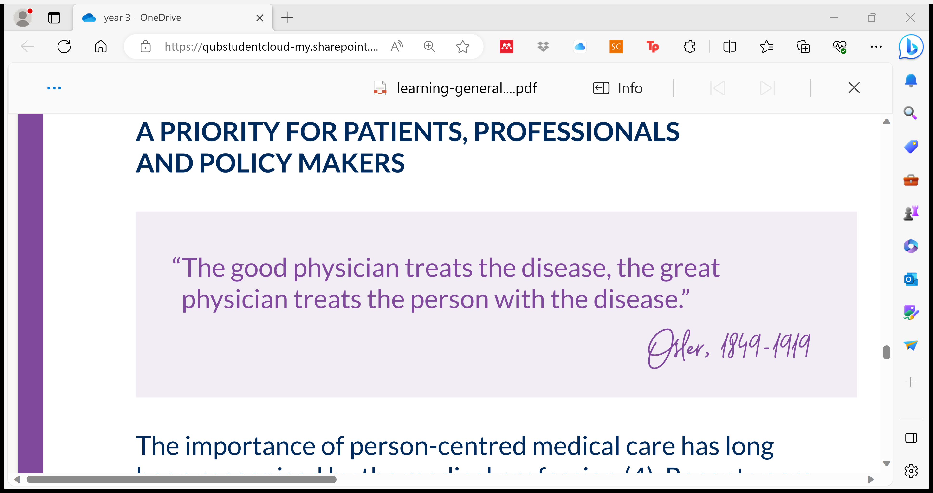
Learning Objective – Effective delivery of Care

Slide 20
What experience have these students had in GP in years 1+2?
Family medicine year 1 + 2
Clinical skills experience
New to QUB

Slide 21
Year 3 GP placement – higher funding
12 Wednesday mornings in your practice
Intro session week 1 LIC
via ZOOM- QUB
Review session week 14 LIC
via ZOOM - QUB
6 students per group
Students working in pairs or greater

Slide 22
Intro Session- what’s included?
Housekeeping
What to expect
MyProgress- Assessement
Myth busting the GP role

Slide 23
GP Practice- Email reminder to students?
Time to be there
Practice location
Parking, bus, train
Who to meet?

Slide 24
What will they do on GP placement?
Hot seating
Case Based Discussion
Telephone consulting
…and lots more!
Time with the practice team

Slide 25
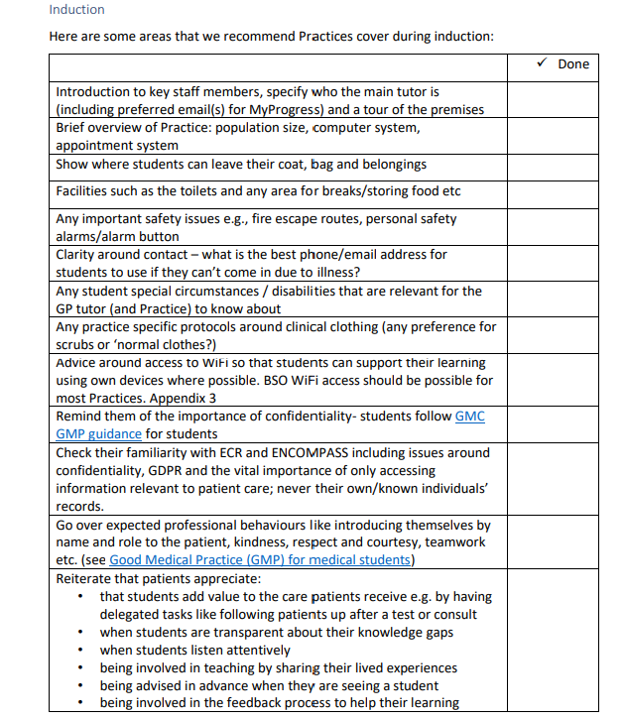
Induction

Slide 26
Clinical Consultation
Home Visit
Telephone call
Face to Face

Slide 27
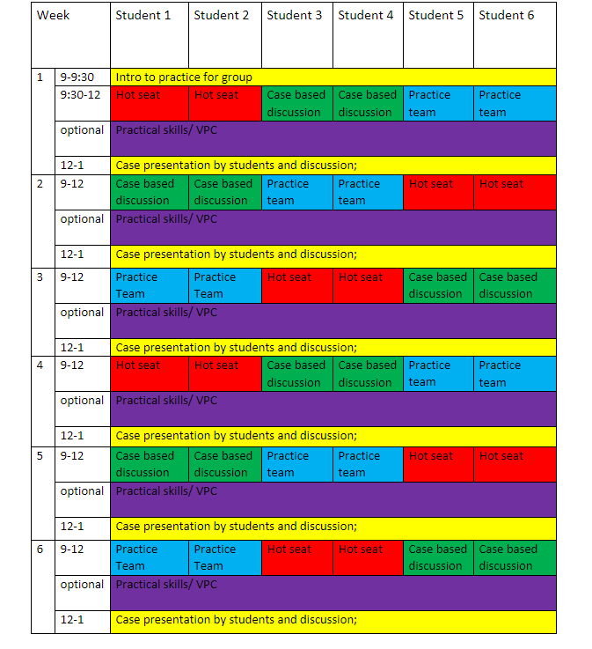
Sample timetable

Slide 28
Any thoughts?

Slide 29
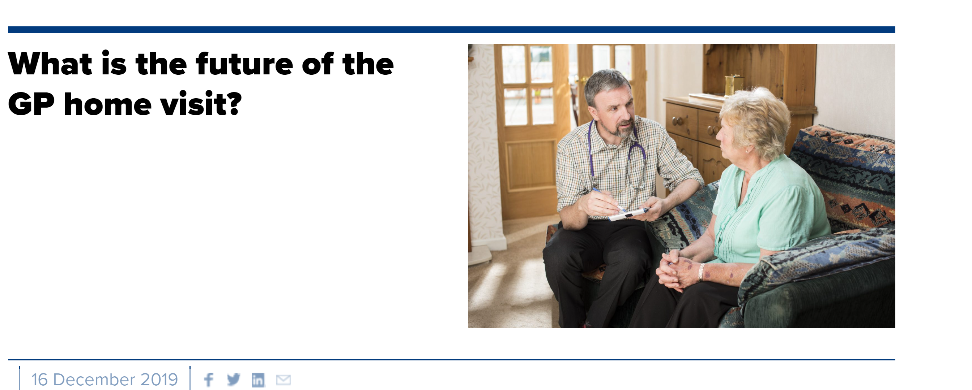
Students and Home Visits

Slide 30
Home Visiting
Seek patient verbal consent in advance of the home visit
Agree time of visit and check who else will be in the home at the time/any animals?
Students should complete a home visit in a minimum of two
Check if students have their own transport or if it is within easy walking distance or can be accessed by public transport
Discuss specific tasks for home consultation

Slide 31
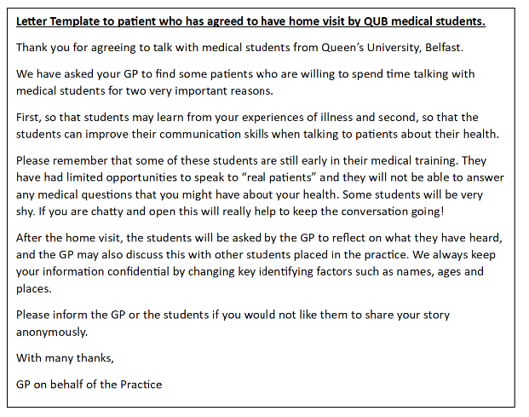
Home Visiting

Slide 32
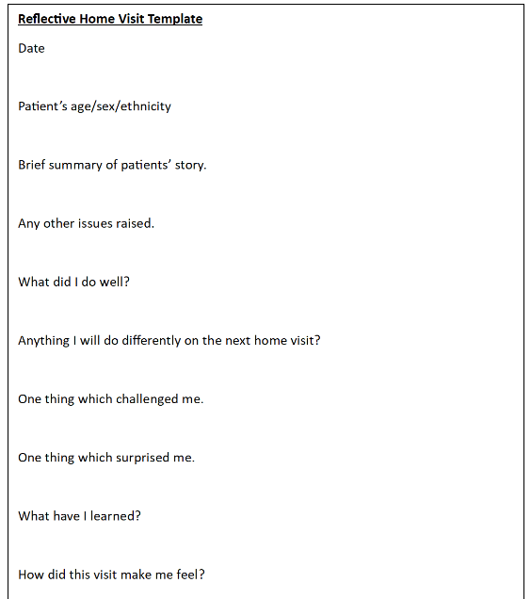
Home Visiting

Slide 33

Healthcare Human Factors
https://vpc.medicalschoolscouncil.or.uk/
NEED
Access to wi-fi
Computer with speakers
Reflecting on the emotional impact of working in health care.

Slide 34
Any thoughts?

Slide 35

MyProgress

Slide 36
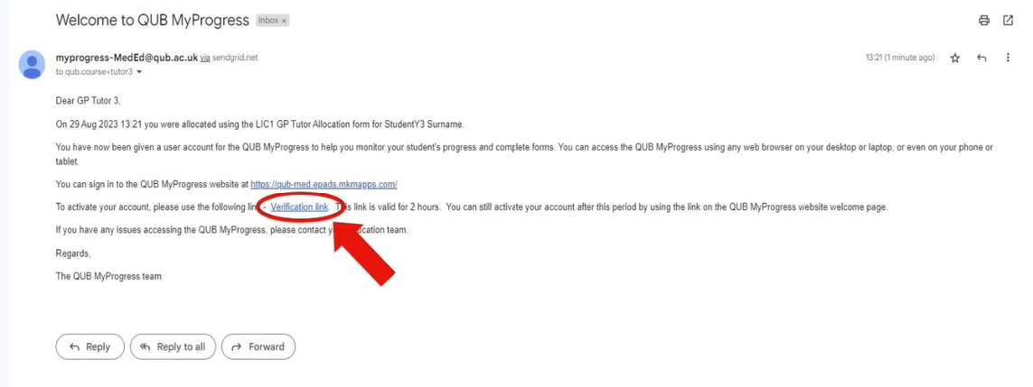
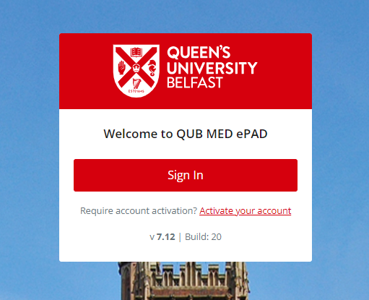
MyProgress – How do I access?

Slide 37
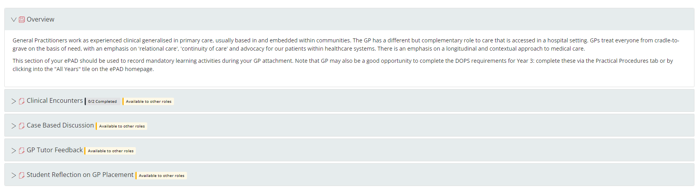
MyProgress Overview

Slide 38

What do they need to complete?
It is the student’s responsibility to ensure that all required elements of MyProgress are completed.
You must complete the GP Tutor Feedback at the end of the 12 week placement.

Slide 39
What must each student complete?
Clinical Encounters – 2 needed
Case-based Discussion (CBD) - 1 needed
Student Reflection on Placement and/or GP Tutor Feedback

Slide 40
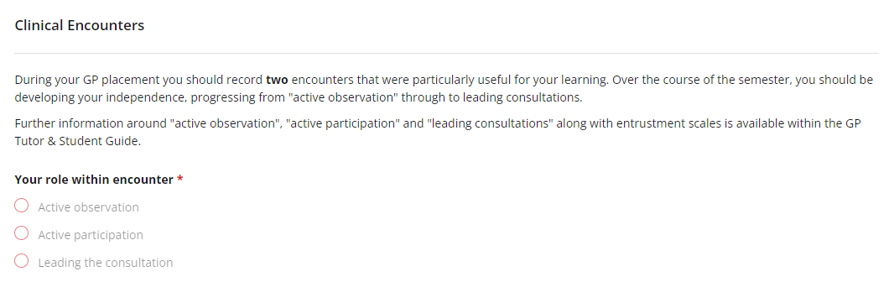
Clinical Encounters x2

Slide 41

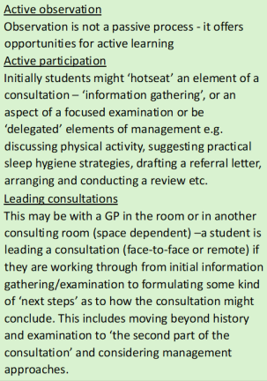
Clinical Encounters x2

Slide 42
Entrustable Professional Activity (EPA) Scale
1 First introduction to skill: observing only
2 Working together with supervisor: co-activity
3 Supervisor steps in as needed: direct supervision
4 Supervisor is in the background: direct supervision
5 Supervisor is next door and checks work at the end: indirect supervision
6 Supervisor is next door and checks key aspects of work: indirect supervision
7 Supervisor is at a distance but available by phone: indirect supervision
8 Independent consulting

Slide 43
Case based Discussion (CBD)x1
CBDs are a structured interview designed to assess a student's professional judgement in clinical cases.
The student will prepare an in-depth exploration of a clinical case.
The student will present the CBD to the GP Tutor and preferably with their peers.
WHAT IS INVOLVED?
Identify one clinical case that, for the student, demonstrates
a reasonably complex case
that may have involved several members of the primary healthcare team
and allows a range of competences (see below) to be demonstrated
e.g. someone recently discharged from hospital following an acute clinical episode, someone actively undergoing hospital care, a patient with a long-term condition or multi morbidity, or someone with palliative care needs.

Slide 44
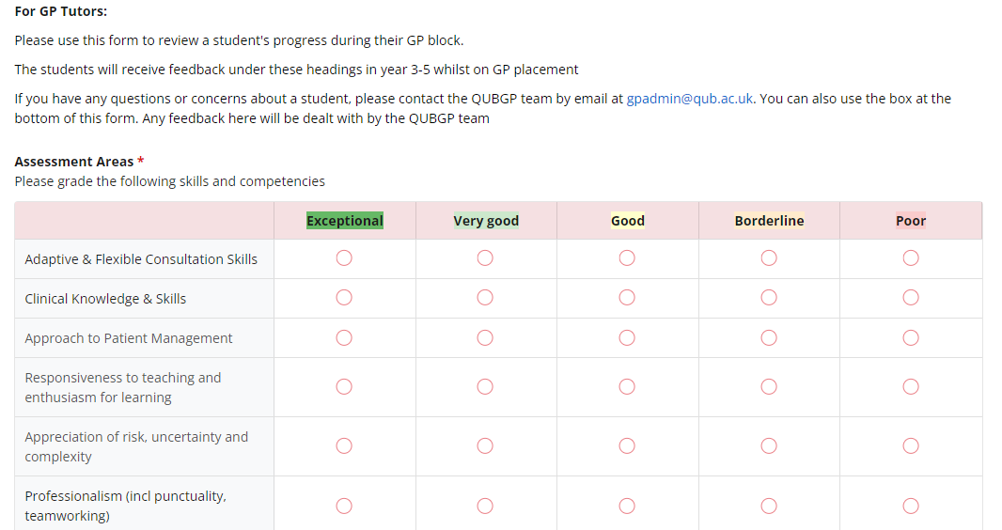
GP Tutor Feedback

Slide 45
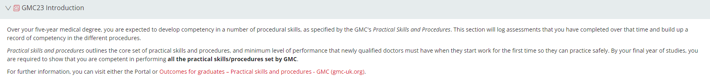
Practical procedures

Slide 46
Any questions?

Slide 47

You are the experts!
Share what went well/didn’t go so well in 23-24
Share new ideas for 24-25
Share potential concerns either personal or practice
Virtual Primary Care (VPC)
Who else can you involve and how?

Slide 48
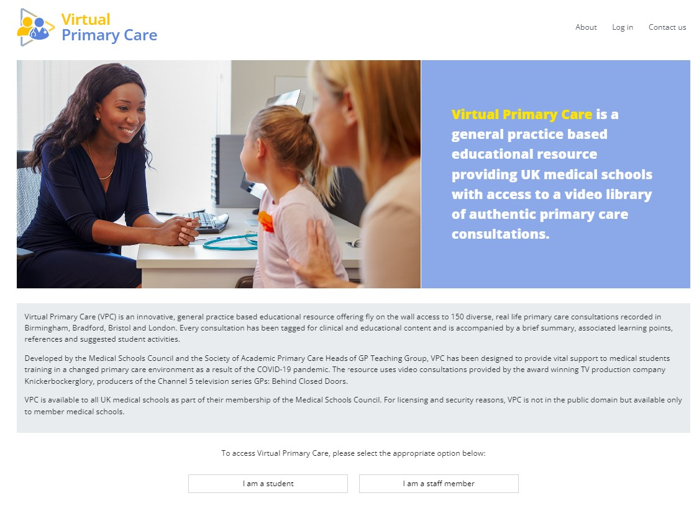
Virtual Primary Care
https://vpc.medicalschoolscouncil.org.uk/
NEED
Access to wi-fi
Computer with speakers

Slide 49
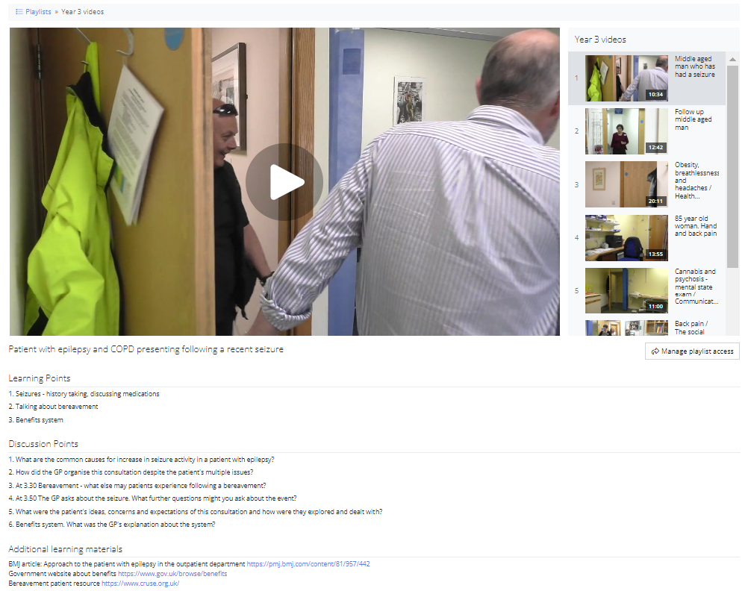
Virtual Primary Care - How best to use on GP placement?

Slide 50
Any thoughts?
Record attendance
If you do NOT have a QUB email address, please let us know

Slide 51

Thank you

